Slide 1
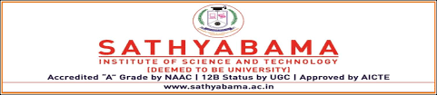
PROFESSIONAL TRAINING PRESENTATION
AT
SATHYABHAMA INSTITUTION OF SCIENCE AND TECHNOLOGY
DEPARTMENT OF COMPUTER SCIENCE&ENGINEERING
BY
Tagini Mythreye M
Topic – Online Bus Ticket Reservation System
REG-39111012
Guide Name: Mrs.C.Kavitha

Slide 2
CONTENTS
Introduction
Objectives
Implementation
Methodology
Choice of Methodology
Structure of Project
User Flow Diagram
Use Case diagram
Application snapshots
Summary
Conclusion

Slide 3
INTRODUCTION
Online bus ticket reservation system is a Web-Based software that operates within a centralized system. online bus ticket reservation system is used to book seats, cancellation of tickets and different type of track queries. it is developed for handling and computerizing the regular database, ticket booking, antravel made
Currently, staff at the bus ticket counter is using an internal system to sell tickets at the counter and customers who are unable to buy bus ticket online at this moment would have to go to the counter to a buy bus ticket.
Sometimes, customers’ needs to queue up a long queue to buy bus ticket and ask for information and this brings a lot of inconveniences to customers.
However, Online Bus Ticket Reservation System enables the customer to buy bus ticket, make payment, and ask for information online easily.
Furthermore, staff can sell bus ticket using Bus Ticket Reservation System after checking the bus ticket availability for the customer and print the bus ticket to the customer.

Slide 4
Project Objective
The main purpose of this study is to automate the manual procedures of reserving a bus ticket for any journey
This system is said to be an automatic system and customers can select seats by themselves. Specifically, objectives of this project will consist of:
Providing a web-based bus ticket reservation function where a customer can buy bus ticket through the online system without a need to queue up at the counter to purchase a bus ticket.
Enabling customers to check the availability and types of busses online. Customer can check the time departure for every ITC bus through the system.
Easing bus ticket payment by obtaining a bank pin after payments is made to the various designated banks.
Ability of customers to cancel their reservation.
Admin user privileges in updating and canceling payment, route and vehicle records.

Slide 5
Implementation
Creating the basic frontend part of the website using the frontend languages
Create components and make their layout with HTML, CSS and JavaScript.
Create features with PHP
Connect the backend to mysql database

Slide 6
Methodology
1. The system of collecting data for research project is known as research methodology.
2. The data may be collected for either theoretical or practical research for example management research may be strategically conceptualized along with operational planning method and change management.
3. Information which was used for this study was carried out by oral interview.

Slide 7
Choice of Methodology
1. For any project to be completed, it must go through stages called Development Life Cycles.
2. System Development Life Cycle (SDLC) is the process of understanding how an Information System (IS) can support business needs, designing the system, building it, and delivering it to users.
3. The SDLC composes of four phases: Planning, Analysis, Design, and Implementation. In order for this project to be developed, the methodology that will be used is the System Structured Analysis and Design Methodology. The SSADM is classified as a Waterfall Development.
4. With Waterfall Development, analyst and users proceed sequentially from one phase to the next and each phase can be mapped out and evaluated (Hevner, 2004).

Slide 8
STRUCTURE OF PROJECT
Administrator
Managing all bus schedule
Managing all bookings
Managing all ticket counters
Managing all tickets
Managing all the customers
Managing all the bus route
Managing all the payment.
User
Bus schedules
Booking details
Reference number for the user

Slide 9
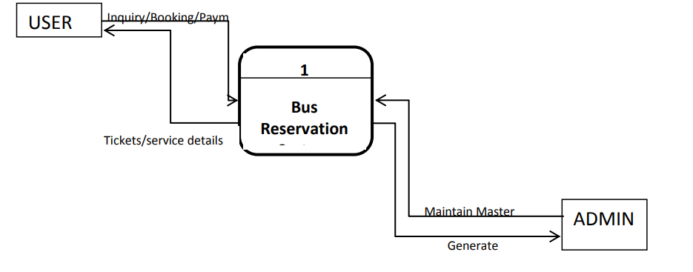
User Flow Diagram Level 0 Context View of Online Bus Ticket Reservation System

Slide 10
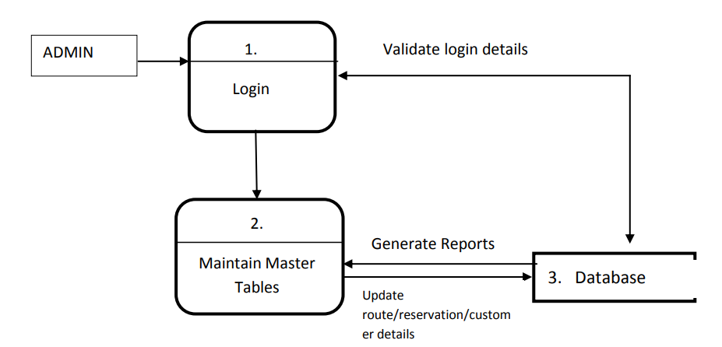
Level 1 User view of Online Bus Ticket Reservation System

Slide 11
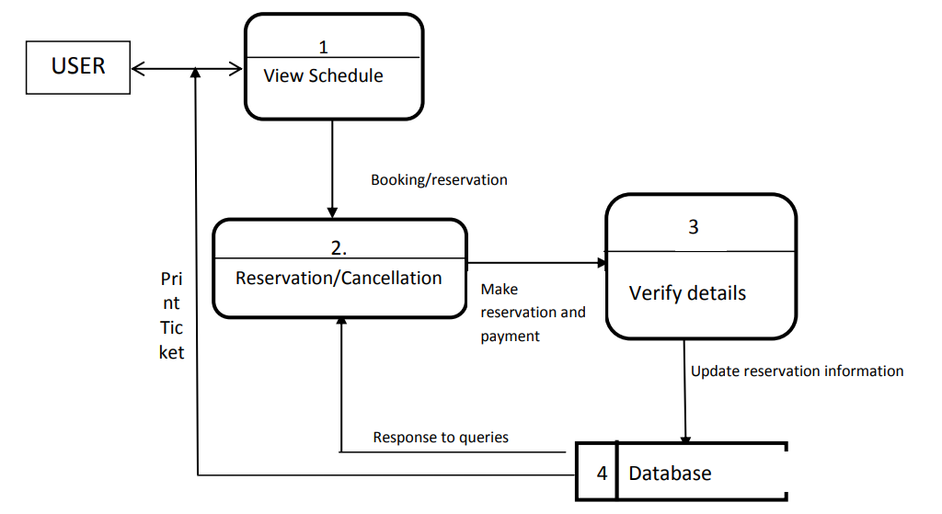
Level 2 Admin view of Online Bus Ticket Reservation System

Slide 12
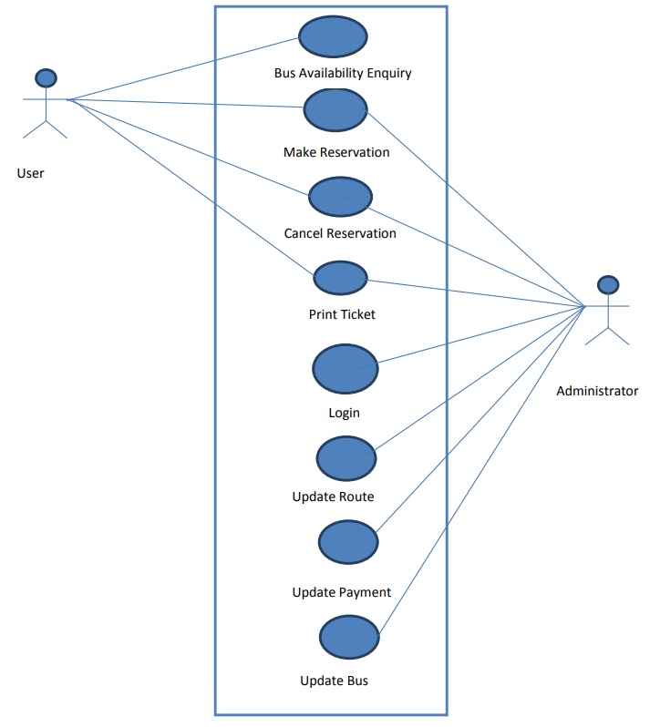
Use case diagram for user and admin

Slide 13
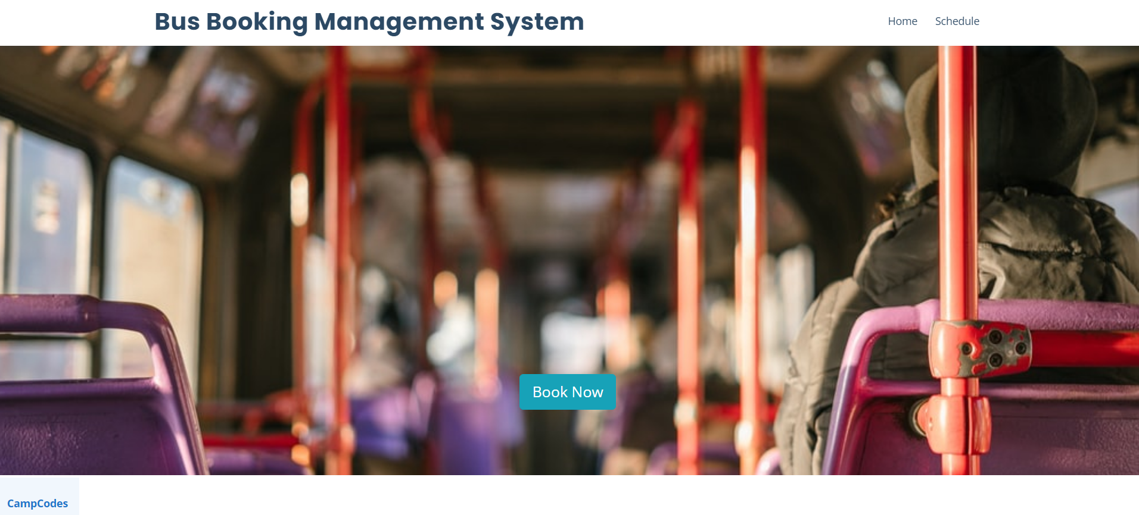
User’s Booking page

Slide 14
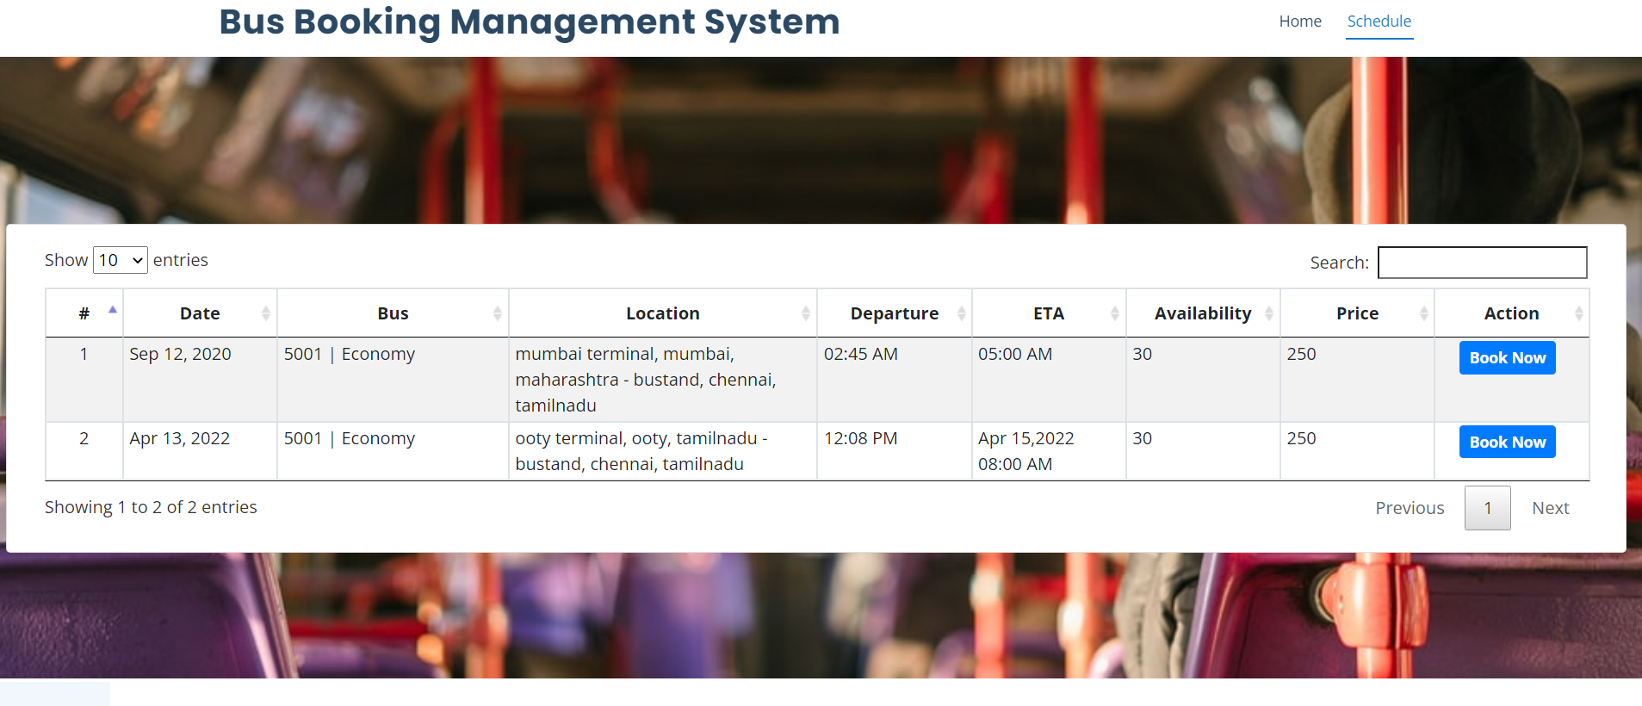
User’s Bus schedule module

Slide 15
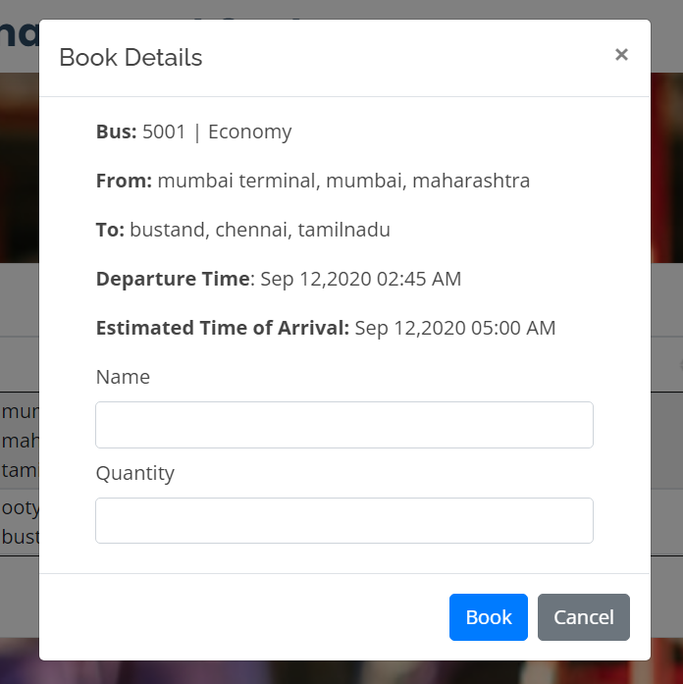
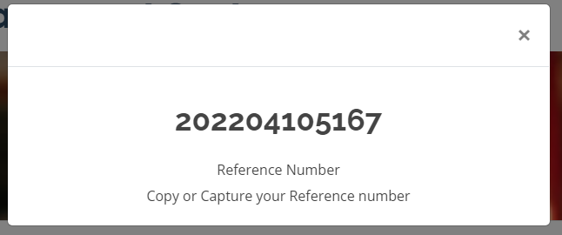
User’s booking details Reference number for the user after booking

Slide 16
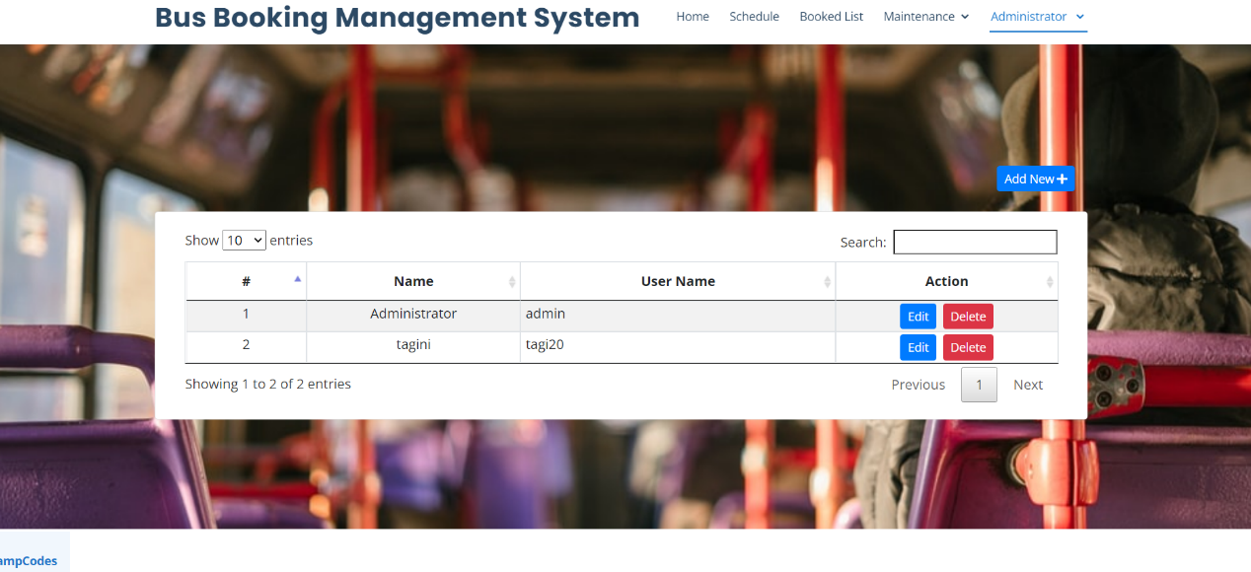
Administration module

Slide 17
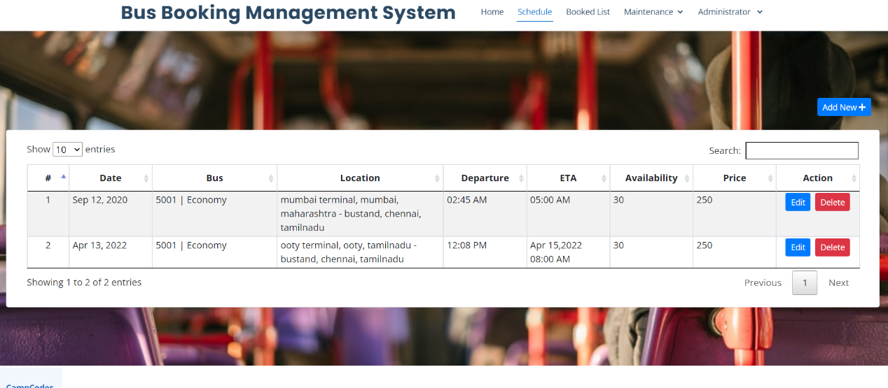
Updated route , payment and bus

Slide 18
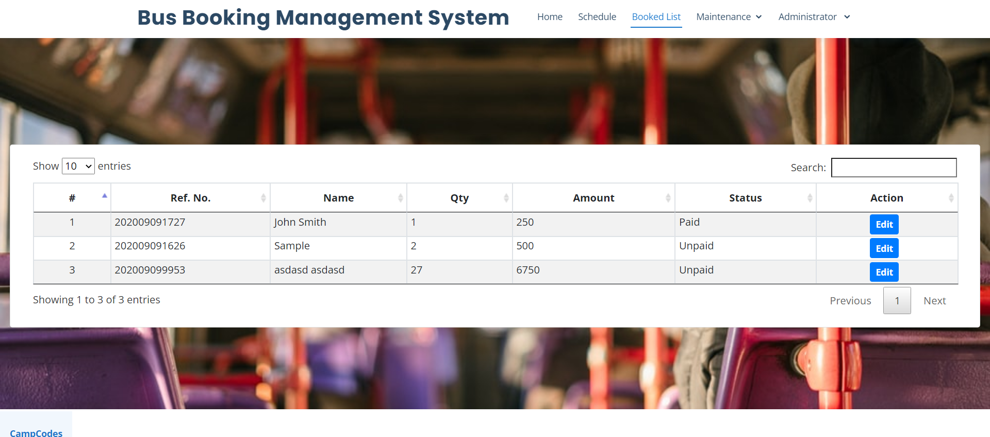
Admin dashboard

Slide 19
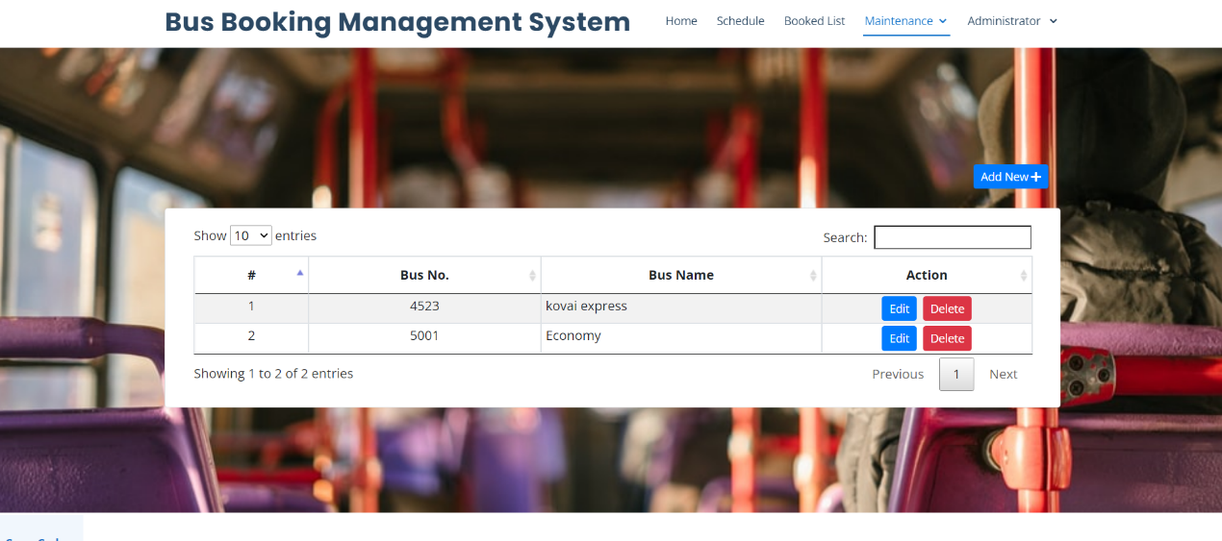
Admin Maintenance module

Slide 20
Summary
In this present era, online booking or reservation system has improved the operations of various sectors of a nation’s economy deploying this system.
Online Bus Ticket Reservation System being a web based system that ensures that the company would be able to transform most of the processes carried out manually into automated, error-free and easy to use operations in the organization especially in the area of transportation; also it would be able to generate report for the management decision purpose.
This system will be developed using a waterfall methodology for research and design purposes, PHP as the
programming language because of its server-side processing capabilities that makes data process less on the
client personal computer, an implementation strategy as well as testing and maintenance strategies suitable
for efficient deployment of the system.

Slide 21
Conclusion
It can be observed that computer applications are very important in every field of human endeavor. Here all the information about customer that made reservation can be gotten just by clicking a button with this new system, some of the difficulties encountered with the manual system are overcome.
It will also reduce the workload of the staff, reduce the time used for making reservation at the bus terminal and increase efficiency.
The application also could update records in various files automatically thereby relieving the company’s staff the stress of working from file security of data.
This project, as a whole, will give a new way in bus reservations and ticketing processes.
The automation and management of seats and reservations will be done online.
However, this project does not limit the walk-in passengers that is passengers who visit the company’s counter because it also caters for them.
This also lessens the use of papers like in the traditional way of ticketing.

